Slide 1
2m Roll-up J-Pole
Dallas N4DDM
GARS Workshop - November 16, 2021
M0UKD’s Slim Jim and J-Pole Calculator
Notes:
Thank folks for showing up
Go over the fire exits, sodas/water for a 1$ donation to the GARS Scholarship Fund
Thank the Elmers for bringing their tools and antenna analyzers
Buckle your seat belts as a I have a few slides to go over before we start builing

Slide 2
2m Roll-up J-Pole
What I’ll touch on for this Workshop
Before we start building I would like to teach a few things about Transmission Lines
Transmission lines; balanced (twin lead, window line, ladder line), unbalanced (coax)
Impedance matching using a ¼ wave matching stub
Impedance matching using non-50-ohm ½ wave transmission line
When life gives you lemons, you make lemonade
Velocity Factor, what it is and how it affects the math
Websites that do the math so you don’t need your slide ruler, calculator, or aspirin
Dallas’ twist to the Roll-up J-Pole that I don’t see anywhere
Notes:
This presentation will be posted on the GARS website
Don’t worry about writing down much

Slide 3
2m Roll-up J-Pole
Roll-up J-Poles can be made for other bands
70cm 420-450 435MHz
1.25m 219-225 222MHz
2m 144-148 146MHz What we will be building
6m 50-54 52MHz
10m 28-29.7 28.85MHz or just the Tech SSB 28.3-28.5 28.4MHz
12m 15m 17m 20m?
Air Band Frequencies, 118-137MHz, 127.5MHz
VHF Marine Band, Ch16 156.800MHz
NOAA Weather 7 channels, Ch 3 162.475MHz My demo from scrap Window Line
FRS/GRMS 22 channels, 465.1315MHz
Notes:
We are going to focus on the 2m Roll-up J-Pole
My DEMO is for the center NOAA Weather Radio channel (CH 3) because it was too short to make a 2m antenna

Slide 4
2m Roll-up J-Pole
Websites used for most of our heavy math skills
M0UKD’s Slim Jim and J Pole Calculator
https://m0ukd.com/calculators/slim-jim-and-j-pole-calculator/
Google; convert cm to inches
https://www.google.com/search?q=convert+cm+to+inches
Times Microwave - Coax Cable Loss Calculator
https://www.timesmicrowave.com/Calculator?
Notes:
Here are some of the websites I used

Slide 5
2m Roll-up J-Pole
Times Microwave Systems - Coaxial Cable Attenuation Calculator
On the next slide I’ll use the Times Microwave Calculator to show losses based on coax
Set the cable type; RG-6, RG-59, RG-58, RG-8x
Set the frequency to 146 MHz...
Plug in the cable length in feet, 20 feet for this antenna
Calculate and compare the results with other cables
Know your losses before you part with your time and money
Every gain on an antenna system is a two-fer
Less loss on transmit AND Less loss on receive
Notes:
On the next slide I’ll use the Times Microwave Calculator to show losses based on coax
I use this site a lot to do cost benefit comparison
Once I set the Frequency and Length I only have to change the Cable type to compare losses.

Slide 6
2m Roll-up J-Pole
50-ohm vs 75-ohm cable
Times Microwave Systems - Coaxial Cable Attenuation & Power Handling Calculator
RG-58 50-ohm 20 feet at 146MHz
Cable Vg 66.0%
Cable loss 5.5dB/100ft - Max Cable Assembly Insertion Loss 1.2dB
https://www.timesmicrowave.com/Calculator?Product=RG-58&RunLength=20&Frequency=146
RG-59 75-ohm 20 feet at 146MHz
Cable Vg 66.0%
Cable loss 4.1dB/100ft - Max Cable Assembly Insertion Loss 0.9dB
https://www.timesmicrowave.com/Calculator?Product=RG-59&RunLength=20&Frequency=146
Notes:
The links to the Times Calculator are for the RG-xx cable, 20’, at 146MHz
Once I set the Frequency and Length I only have to change the Cable type to compare losses.

Slide 7
2m Roll-up J-Pole
50-ohm vs 75-ohm cable
Times Microwave Systems - Coaxial Cable Attenuation & Power Handling Calculator
RG-8X 50-ohm 20 feet at 146MHz
Cable Vg 66.0%
Cable loss 4.5dB/100ft - Max Cable Assembly Insertion Loss 1.0dB
https://www.timesmicrowave.com/Calculator?Product=RG-59&RunLength=20&Frequency=146
RG-6 75-ohm 20 feet at 146MHz
Cable Vg 66.0%
Cable loss 3.3dB/100ft - Max Cable Assembly Insertion Loss 0.7dB
https://www.timesmicrowave.com/Calculator?Product=RG-6&RunLength=20&Frequency=146
Notes:
The links to the Times Calculator are for the RG-xx cable, 20’, at 146MHz

Slide 8
2m Roll-up J-Pole
WHAT!!! 75-ohm cable has less loss than 50-ohm
The story I heard was the Navy wanted the best coax…
Coax is a compromise, you can get low loss OR high power, not BOTH…
35-ohm cable can handle more power but doesn’t like high SWR...
75-ohm cable has less loss, that’s why the cable TV industry uses it...
50-ohm is somewhere in the middle…
Notes:
Don’t go down memory lane with Navy stories...

Slide 9
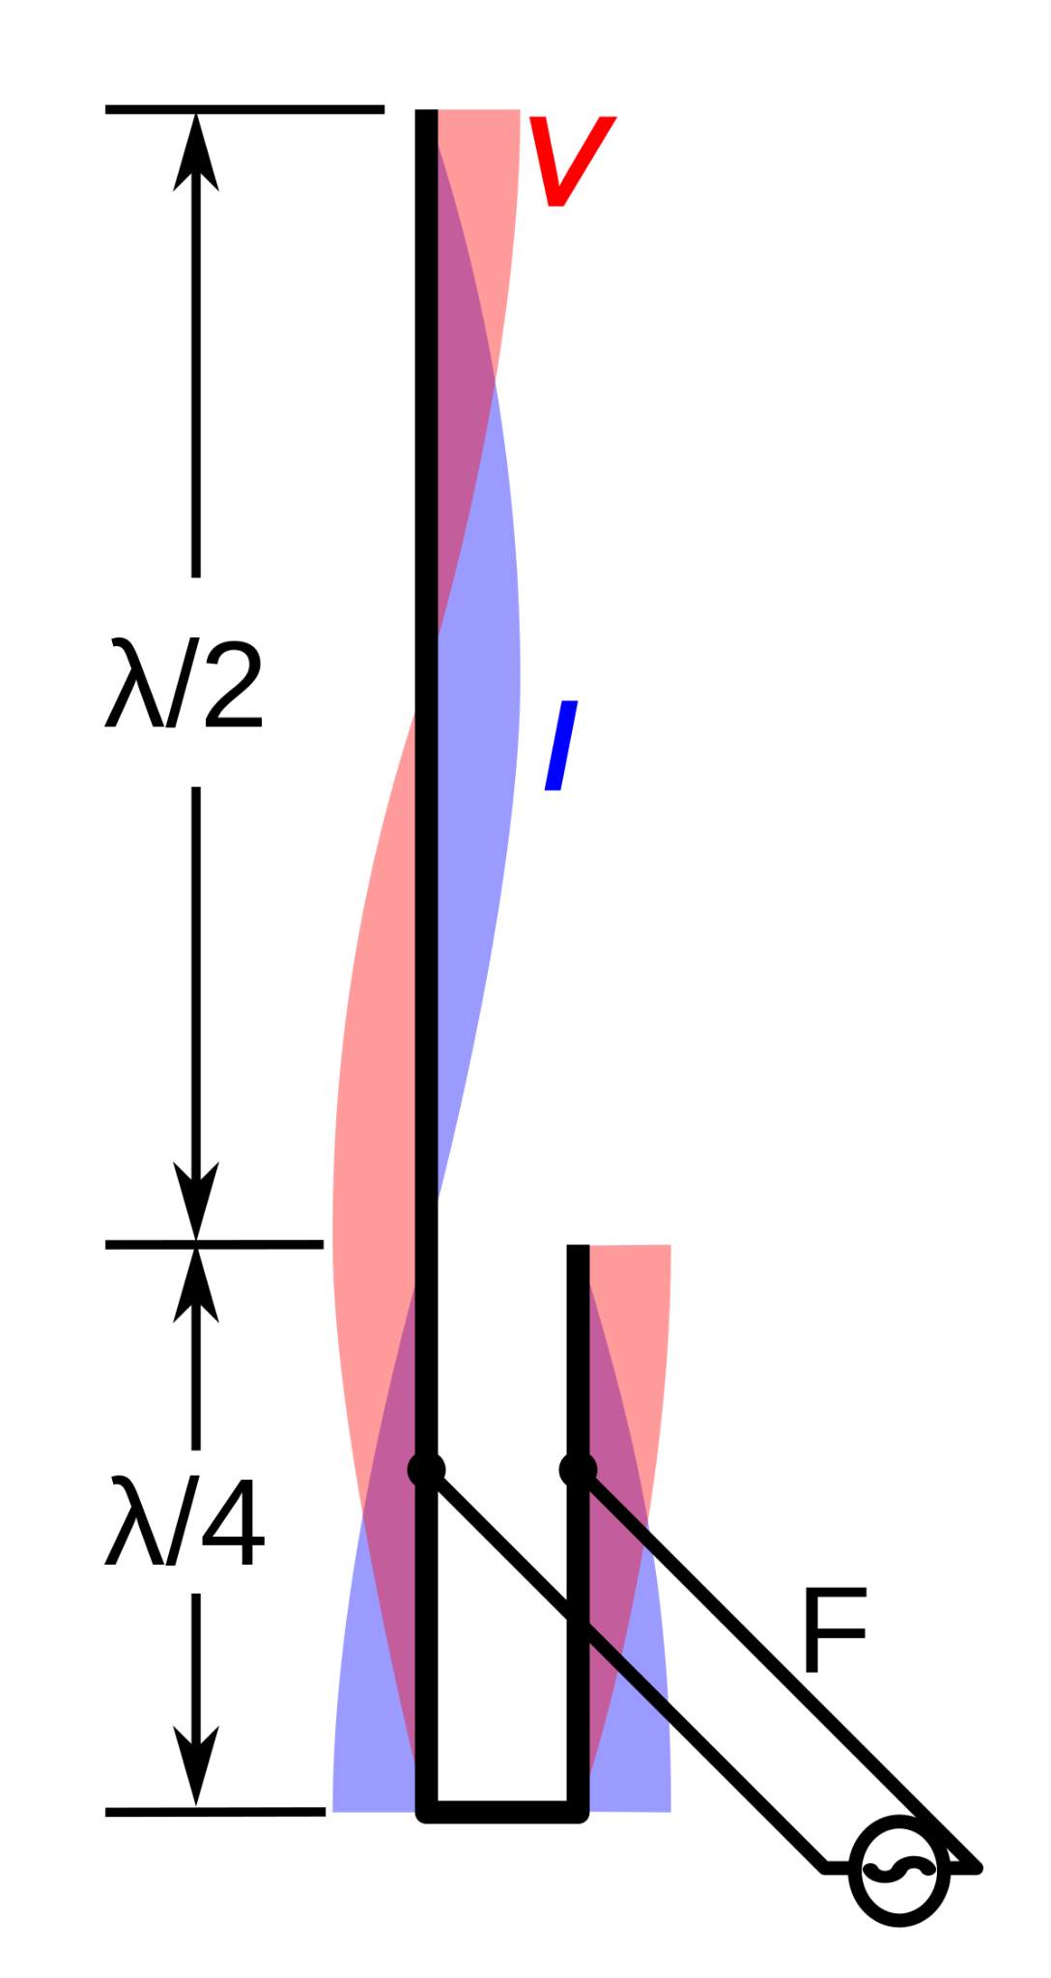
The Quarter Wave Stub
Magical Properties
The short at the bottom reflects as an open at the top
Easy to visualize as we can see the short and the open
What’s hard to visualize is that at some point between the open and short there is a 50-ohm impedance point
The J-Pole calculator does the math to find that 50-ohm impedance point
In this case it is used to match the coax impedance to the open end of the ½ wave antenna
This is just like using a balun to match 50-ohm cable to the end of a EFHW HF antenna
Notes:
Speak about the bullet points
Hold up my demo antenna and show the ¼ stub, coax feed point, and ½ wave antenna

Slide 10
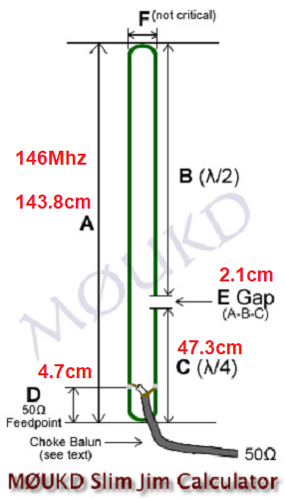
Maybe a future Workshop
I’ve been told that the top section can be a 5/8s wave for a little more gain
https://en.wikipedia.org/wiki/J-pole_antenna
Notes:
Go over the ½ wave section, the ¼ wave tuning stub, 50-ohm impedance point
By the way there is lots of J-Pole information on WikiPedia
I’ve never built one but I’ve been told that you can make a 5/8s wave J-Pole for a little more gain

Slide 11
2m Roll-up J-Pole
The Half Wave Stub - We only need this if we are going to use 75-ohm cable
Different Magical Properties
Becomes a 1:1 impedance transformer
Meaning it matches the input impedance to the output impedance
So your 50-ohm radio sees the 50-ohm antenna
(Wavelength / 2 ) x Velocity Factor
We will use the J-Pole calculator but we will use the Vg factor for RG-59 which is 66%
Belden 8241 RG-59/U Velocity Factor 66%
https://catalog.belden.com/techdata/EN/8241_techdata.pdf
67.8cm = 26.69291 inches x 9 = 240.23619 inches = 20.0196825 feet
Use an Antenna Analyzer or Vector Network Analyzer to trim your 20+ foot cable
Notes:
We only need this if we are going to use 75-ohm cable AND want the lowest loss
Explain why we would do this
FREE coax
Lower our losses
We could just take the 1.5 SWR hit as that’s only a 4% loss

Slide 12
2m Roll-up J-Pole
Coax Balun
What is a Coax Balun and why do we want/need one
When you transition from unbalanced to balanced transmission line, current can run down the outer skin of the coax and radiate distorting the radiation pattern of your antenna
Think of a nice beam pattern with great front to back ratio distorted by a vertical run of coax
It can also put unwanted RF in your shack causing RF burns
At 146MHz, 3-4 turns for coax should fix this
It also lets you secure the coax to the base of the antenna so no stress is on the soldered connection.
Notes:
Go over the bullet points on why we want a 3-4 turn Coax Balun

Slide 13
2m Roll-up J-Pole
To facilitate building the antennas I have construction tips
On the demo antenna:
See how to make the top and bottom shorts adjustable.
This lets you tune the 50-ohm point by moving the bottom short
Moving the top short adjust the antenna length
On the 2x4 note the dimensions show where to mark your Window Line:
Top and bottom shorts (Try to center them on a solid section of the Window Line)
50-ohm impedance point (Try to center this on an open section of the Window Line)
Gap (Try to center this on a solid section of the Window Line OR on a small window)
Leave room at the top and bottom to hang the antenna and mount the 3-turn coax balun
Notes:
Show-n-Tell; Show/Talk about the Demo Antenna and 2x4 with the dimensions
Explain the wire sliders to adjust the top and bottom shorts
Explain the use of my 2x4 so you line up the Window Line so the GAP is centered on a solid section of the window line
Also to leave room at the top and bottom to hang the antenna and secure the 3-turn Coax Balun

Slide 14
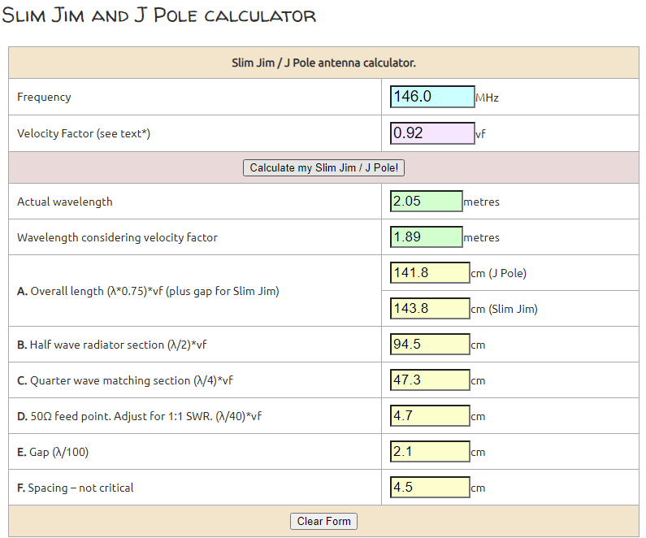
https://m0ukd.com/calculators/slim-jim-and-j-pole-calculator/
= 56.61 ins
= 18.62 ins
= 1.85 ins
= .83 ins
Notes:
I hope this is not an eye chart
The link to M0UKD’s website is given
Note the CENTIMETERS to INCHES math is done in BLUE
These markings are on the 2x4

Slide 15
2m Roll-up J-Pole
All About Circuits - College level info on ¼ and ½ wave transmission lines
Impedance Transformation - Chapter 14 - Transmission lines
https://www.allaboutcircuits.com/textbook/alternating-current/chpt-14/impedance-transformation/
https://www.allaboutcircuits.com/textbook/alternating-current/chpt-14/standing-waves-and-resonance/
Notes:
Homework:
College level info on ¼ and ½ wave transmission lines

Slide 16
2m Roll-up J-Pole
What I’ll hope you took away from this Workshop
When you see a J-Pole antenna you will see and know the parts that make it work
½ wave radiating element
¼ matching network
The 50-ohm impedance point
Balun
Transmission lines can do more than get your signal from your radio to your antenna
Matching networks
Filters
Notes:
What I’ll hope you took away from this Workshop

Slide 17
2m Roll-up J-Pole
How to make your next J-Pole antenna better?
How about making the top section ⅝ wave for more gain?
How about making it out of copper pipe? (also known as a Copper Cactus)
How to add 3dB of, low cost, bi-directional amplification using passive components?
That’s 3dB gain on transmit and 3dB gain on receive
Your 5 watt HT would have 10 watts of punch
Your 50 watt radio would have 100 watts of punch
How many of y’all would like to build a J-Pole out of copper pipe?
How many would like to build a collinear J-Pole with 3dB more gain?
Notes:
Bait the crowd to build a collinear 2m J-Pole out of copper pipe

